Slide 1

OlouXi

Slide 2



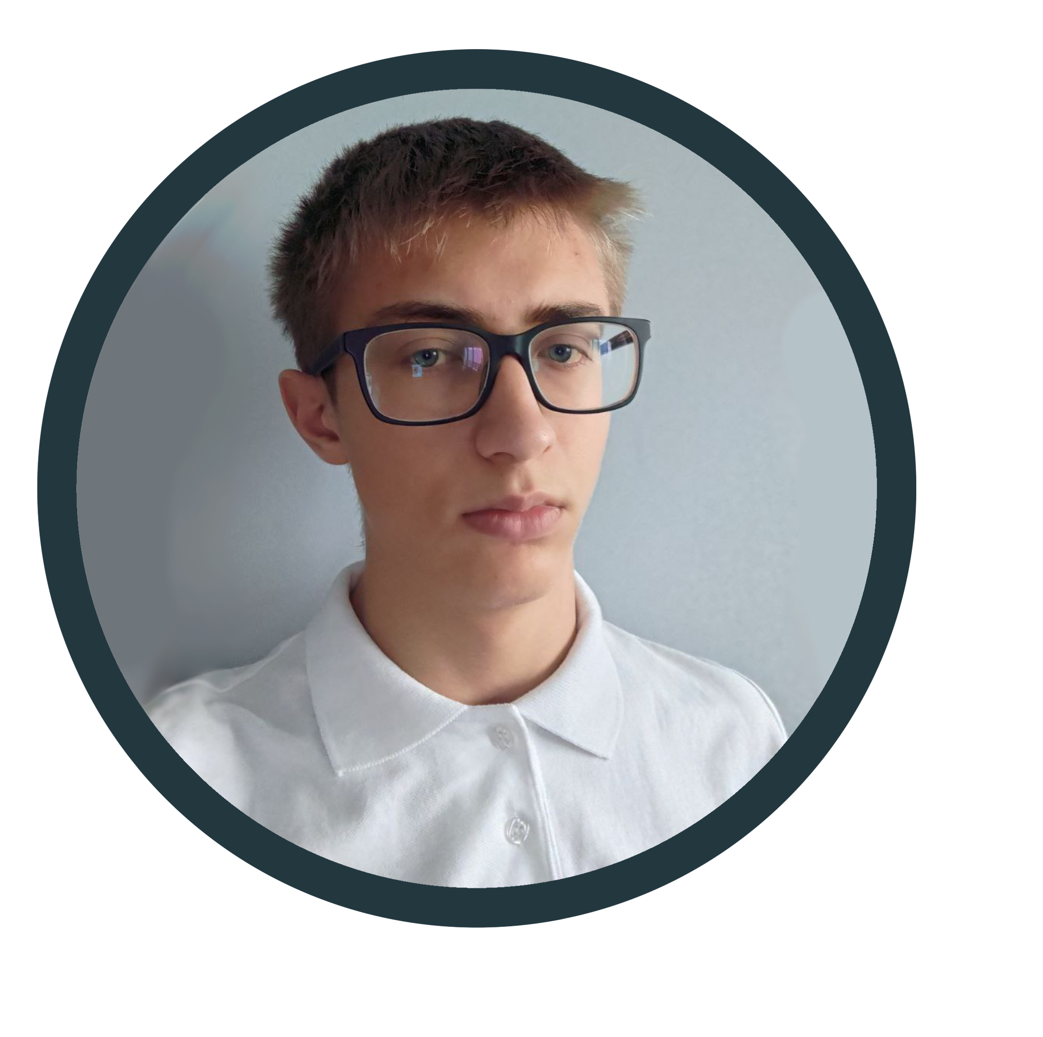
Our Team
Valentin Sergiyovich Nikolenko
Nikita Vyacheslavovich Baladin
Anna Alexandrova Rikova

Slide 3


Realization
Idea
Front - End
Back - End
Presentation

Slide 4








Used Technology

Slide 5
Now let's see the Repo

Slide 6
Demonstration

